Slide 1


Environmental
Reserve Bylaw Highlights
Prepared by Planning and Development and
Environmental Services

Slide 2
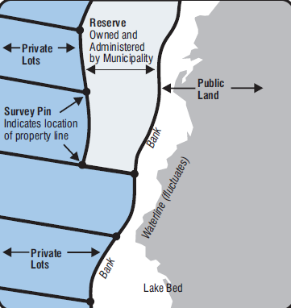
What is the purpose of Environmental Reserve Lands?
County owned Environmental Reserve [ER] lands are intended to protect the natural environment, protect people and property from hazardous conditions (e.g. flooding) and provide public access to or along lakes and rivers.

Slide 3
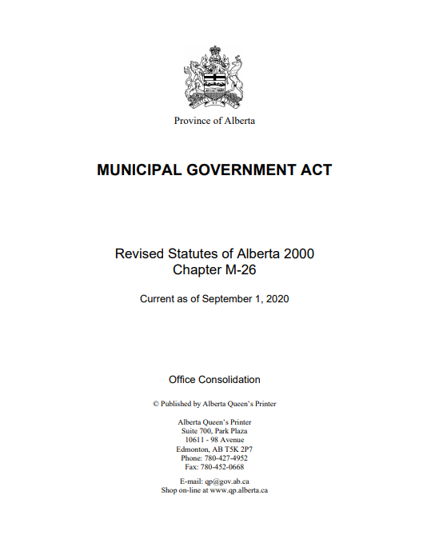

Existing Regulations:
Section 671(1) of the Municipal Government Act states that: environmental reserve must be left in its natural state or be used as a public park.
Section 676 (1) of the Municipal Government Act states that: a council may by bylaw, after giving notice in accordance with section 606 and holding a public hearing in accordance with section 230
(a) use an environmental reserve for a purpose not specified in section 671(1)
Section C1.13 of Lac La Biche County’s Land Use Bylaw 17-004 states that: no encroachment on environmental reserve land shall be permitted.
Lac La Biche County’s Riparian Setback Matrix Policy PI-63-003 recognizes the need to prevent deleterious substances from entering waterbodies with the implementation of municipal policy and in accordance with provincial legislation for long-term watershed sustainability.
Lac La Biche County’s Environmental Reserve Encroachment Policy PI-63-004 deems it appropriate to deal with encroachments on environmental reserve in a consistent manner that protects the integrity of the natural environment and the specific intent of the environmental reserve designation.

Slide 4
What if we stayed with status quo
(Current MGA, Land Use Bylaw & Policy Regulations)
Pros:
Cons:
No changes to current bylaws or policies required
Aligns with Council’s Strategic Plan 2019-2024 with respect to Environmental Sustainability
Current Land Use Bylaw and Policies prevent the ability to enter into any agreements on ER lands and use is restrictive on all municipally owned lands
The ER policy cannot be enforced, unlike a bylaw which is a statutory document
Sections of Lac La Biche County’s Land Use Bylaw 17-004 and Environmental Reserve Encroachment Policy PI-63-004 do not align and contradict one another
Council wished to find an appropriate balance of the feedback received through public consultation, provincial regulations and the County’s own environmental and land management goals

Slide 5
Why an Environmental Reserve Bylaw?
Lands dedicated as Environmental Reserve are owned and regulated by Lac La Biche County. These lands are designated to protect environmentally sensitive lands or to be used as a public park.
Although Lac La Biche County has existing Policies that regulate the use of Environmental Reserve lands, a Bylaw is necessary in order to enforce the non-permitted activities and apply fees and fines.
Lac La Biche County’s Land Use Bylaw currently specifies that there shall be no encroachment on Environmental Reserve lands.
Taking into consideration the feedback received during the multiple public engagement sessions, Council believes that certain activities may be permitted on Environmental Reserve lands, providing the proper approvals and agreements are in place.
The new version of the draft Environmental Reserve Bylaw 20-036 will allow an opportunity for residents to apply to Council for approvals regarding certain uses on Environmental Reserve lands.

Slide 6
With respect to vegetation maintenance
2018 version of the draft Environmental Reserve Bylaw
2020 version of the draft Environmental Reserve Bylaw
ER lands shall remain in their natural state and are available for public enjoyment and the preservation of vegetation
Exceptions:
  Hand-pulling weeds (as identified in the Weed Control Act)
  Mowing a single meandering trail, maximum of 2.0 meters ( 6.6 ft) from an abutting landowner’s private property to the lake-ward side of that parcel
ER lands must be left in its natural state or be used as a public park
Exceptions:
  Hand-pulling weeds (as identified in the Weed Control Act)
  Abutting landowners may clear and maintain a single meandering trail which shall be:
    A maximum of 3.05 meters (10.0 ft) wide
    Lead from a private lot to the lake-ward side of that parcel
Where unauthorized removal or disruption of vegetation occurs on ER lands which is not permitted by this Bylaw, the County may require the responsible person(s) to re-vegetate the area within one growing season – at their expense
Large dead or mature dying trees may be removed by the County if they pose a safety threat by windfall
Manicured grass areas will be maintained if there is a clear, defined need for public park areas and maintained by the County
Lac La Biche County’s Land Use Bylaw 17-004 currently permits hand-pulling weeds, in accordance with the Weed Control Act and the mowing of a 2.0 m (6.6 ft.) meandering trail across ER lands.

Slide 7
With respect to restrictions on prohibited activity
2018 version of the draft Environmental Reserve Bylaw
2020 version of the draft Environmental Reserve Bylaw
No person shall:
  injure or remove any turf, tree, shrub, plant or any other vegetation;
  construct any structure;
  excavate, dig or remove any natural feature;
  place or erect any structures, signs, bulletin board, post, pole, or advertising device of any kind, or attach any notice, bill, poster, sign, wire, or cord to any tree, shrub, fence, railing , post or structure;
  conduct or engage in any activity which in the opinion of a Peace Officer causes a disturbance to anyone’s peaceful enjoyment of public or private property;
  County signs marking the environmental reserve, shall not be altered, defaced, or removed;
  deposit or store building materials/topsoil/clay/sand/rock or other aggregate;
  discard contaminates or apply pesticides, herbicides, or fertilizers;
  discard any litter;
  camp or otherwise take up occupancy;
  light any outdoor fire;
  discharge any firearms, fireworks, or other projectiles; or
  cause or permit livestock to graze;
No person shall:
  planting, injure or remove any turf, tree, shrub, plant or any other vegetation;
  construct or place any unauthorized structure;
  excavate, dig or remove any natural feature with machinery;
  place or erect any signs, bulletin board, post, pole, or advertising device of any kind, or attach any notice, bill, poster, sign, wire, or cord to any tree, shrub, fence, railing, post or structure;
  conduct or engage in any activity that causes a disturbance to anyone’s peaceful enjoyment of public or private property;
  alter, deface, or remove County signs marking the Environmental Reserve;
  deposit or store building materials/ firewood/ grass clippings/ topsoil/ clay/ sand/ rock or other waste;
  discard contaminates or apply pesticides, herbicides, or fertilizers;
  discard any litter;
  camp or otherwise take up occupancy;
  cause or permit livestock to graze; or
  construct a retaining wall or install erosion controls;

Slide 8
With respect to access
2018 version of the draft Environmental Reserve Bylaw
2020 version of the draft Environmental Reserve Bylaw
The County may provide designated public access to a water body over ER lands
Vehicular access over ER lands will be permitted twice a year
The County may provide designated public access to a water body over ER lands
Abutting landowners may apply for a permit and agreement to access a water body over ER lands. This can include the construction of stairways and or boardwalks as a mean of access
Vehicular access will be permitted to cross ER lands twice a year, unless otherwise approved by the County in advance
The County may provide designated public access to a water body over ER lands
Lac La Biche County’s Land Use Bylaw 17-004 currently permits vehicular access directly across Environmental Reserve Lands if done so in the least damaging manner.
Lac La Biche County’s Environmental Reserve Encroachment Policy PI-63-004 permits access twice a year

Slide 9
With respect to major existing encroachments
2018 version of the draft Environmental Reserve Bylaw
2020 version of the draft Environmental Reserve Bylaw
Application to the County may be made to allow major encroachments existing as of the date of the passing of the bylaw. Such applications would be decided by Council. Encroachment agreements may be required and may be time limited
Existing major encroachments may remain, with proper agreements in place
Existing major encroachments which do not receive approval will be removed
Lac La Biche County’s Land Use Bylaw 17-004 and Encroachment Agreement Policy P1-61-014 currently prohibits any major encroachments on Environmental Reserve Lands. Existing encroachments would have to be removed to comply with current regulations.

Slide 10
With respect to new major encroachments
2018 version of the draft Environmental Reserve Bylaw
2020 version of the draft Environmental Reserve Bylaw
Application to the County may be made to allow major encroachments existing as of the date of the passing of the bylaw. Such applications would be decided by Council. Encroachment agreements may be required and may be time limited
Council will review all applications for new proposed major encroachments
Abutting landowners are required to enter into an agreement and may require further permit approvals
The construction of stairs and or boardwalks are considered as major encroachments and may be permitted with a proper agreement and may be subject to further permit approvals
Council will not accept applications or proposals for the construction of dwellings and or accessory buildings and or sea cans on ER lands
Lac La Biche County’s Land Use Bylaw 17-004 and Encroachment Agreement Policy P1-61-014 currently prohibits any new major encroachments on Environmental Reserve Lands

Slide 11
With respect to minor encroachments
2018 version of the draft Environmental Reserve Bylaw
2020 version of the draft Environmental Reserve Bylaw
Encroachments on ER lands are prohibited
Minor encroachments which are non-permanent surface improvements not more than 0.2 m (6.6 ft.) in height and 5.0 m² (535.0 ft²) are permitted
New applications for minor encroachments will be considered by Council and subject to an agreement and may require further permit approvals
Permanent fire pits are prohibited. Exception made for portable propane fire receptacles
Lac La Biche County’s Land Use Bylaw 17-004 and Encroachment Agreement Policy P1-61-014 currently prohibits any minor encroachments on Environmental Reserve Lands. Existing encroachments would have to be removed to comply with current regulations

Slide 12
With respect to temporary piers and boatlifts
2018 version of the draft Environmental Reserve Bylaw
2020 version of the draft Environmental Reserve Bylaw
Temporary piers and boatlifts may only be stored on ER lands with prior written authorization from the County
Unauthorized temporary pier and boatlifts located on ER lands will be removed and impounded
Temporary piers and boatlifts may be stored on ER lands with prior written permit and agreement
  No storage on bed and shore
  Shall be stored in the least damaging location
  Vegetation shall not be removed to accommodate temporary storage
  Access to the remainder of ER lands to the public shall not be obstructed
Lac La Biche County’s Land Use Bylaw 17-004 currently permits winter storage of piers and boatlifts between October 1 and May 31 (with conditions)
Lac La Biche County’s Encroachment Reserve Policy PI-63-004 currently prohibits the storage of boats and trailers on ER lands.

Slide 13
With respect to penalties
2018 version of the draft Environmental Reserve Bylaw
2020 version of the draft Environmental Reserve Bylaw
A person who is guilty of an offence may pay the applicable penalty amount specified in Schedule “A” or a minimum penalty of $1,000.00 for a first offence and $2,500.00 for any subsequent offence for which a fine is not otherwise established in Schedule “A”
A person who is guilty of an offence is liable to a fine specified in Schedule “A” or a minimum penalty of $500.00 for a first offence doubling upon any subsequent offence for which a fine is not otherwise established in Schedule “A”. Fines and penalties shall not exceed more than $10,000 or to imprisonment for not more than one year, or both

Slide 14
With respect to compliance and enforcement
2018 version of the draft Environmental Reserve Bylaw
2020 version of the draft Environmental Reserve Bylaw
Where the Designated Officer finds that a development or use of an environmental reserve is not in accordance with this Bylaw, the Designated Officer may, by Order to Remedy, order the person in possession of the adjacent land or the person responsible for the contravention or all or any of them to:
  stop the development or use of the environmental reserve land in whole or in part as directed by the notice; and
  demolish, remove, or replace the development and restore the natural features of the environmental reserve; and
  take such other measures as are specified in the notice so that the development or use of the environmental reserve is in accordance with the Act, the regulations, a development permit, a subdivision approval, or this Bylaw, as the case may be.
A Peace Officer is hereby authorized and empowered for the purposes of this Bylaw:
  to enforce any part of this Bylaw within the County;
  issue a Violation Ticket under of the Provincial Offences Procedure Act;
  access or enter upon any County owned land or structure located in whole or in part on County owned land at any time for inspection for compliance with or enforcement of this Bylaw;
  order any person to cease and desist any activity on County owned land, when, in the opinion of the Peace Officer, such activity may compromise the quality of the land, and order the remedy of any disturbed County owned land and;
  remove or seize and dispose of any unauthorized Encroachment, structure, or other item located in whole or in part on County owned land in contravention of this Bylaw or the Act.

Slide 15
Next Steps
On December 8, 2020 Administration presented to Council an amended draft of Bylaw 20-036 for approval
Council has directed Administration conduct public engagement of the draft Environmental Reserve Bylaw prior to bringing it for first reading
Draft Bylaw 20-036 will be available on Lac La Biche County’s website and available for copies. The County’s email: draftbylaw@laclabichecounty.com will be reinstated immediately as an avenue for residents to provide their comments
Administration will prepare public consultation early in 2021 respecting all COVD-19 protocols and regulations
First reading to Bylaw 20-036 in the first quarter of 2021

Slide 16



Please feel free to contact us:
Mail:
Email:
draftbylaw@laclabichecounty.com
Lac La Biche County
PO Box 1679
Lac La Biche, AB T0A 2C0
Call:
1-780-623-6775
Lac La Biche County’s Planning and Development Department and Environmental Services
are located at the County Center office: 13422 HWY 881
Please call in advance to schedule an in-person appointment

